Slide 1


OrderNEXT UK & IE Project
DevOps approach
January 2019
B1-UK-F-1, Date

Slide 2
agenda
What is DevOps ?
IIB CI Demo
IIB-deployment-process
Java-deployment-process
Mainframe DevOps plan
Brief on OpenStack, Bitbucket, Jenkins etc
Questions

Slide 3

What is DevOps ?

Slide 4
IIB CI Demo

Slide 5
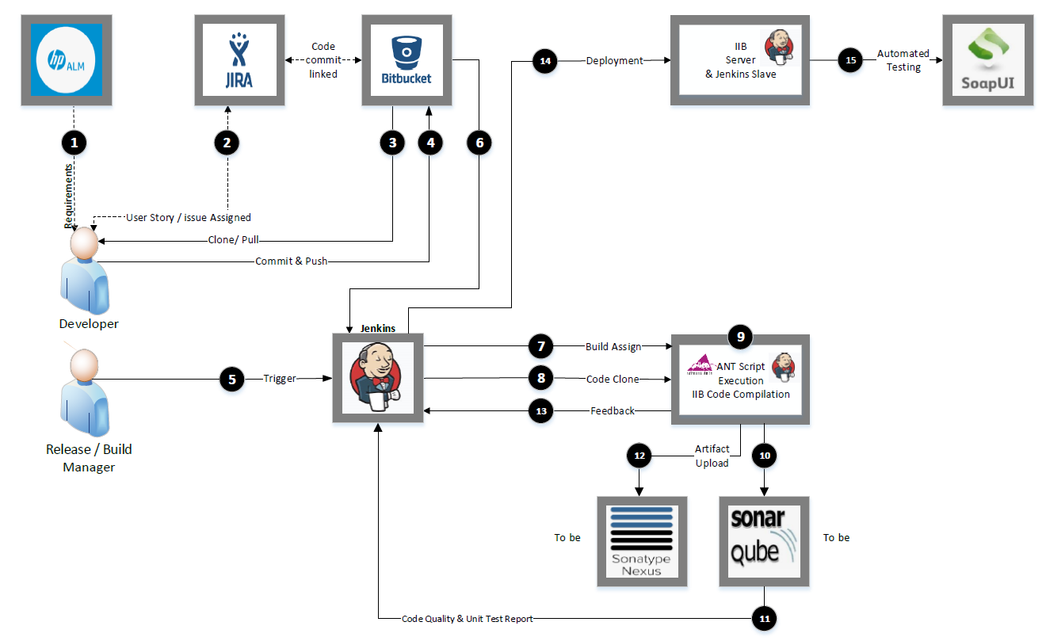
IIB-deployment-process

Slide 6
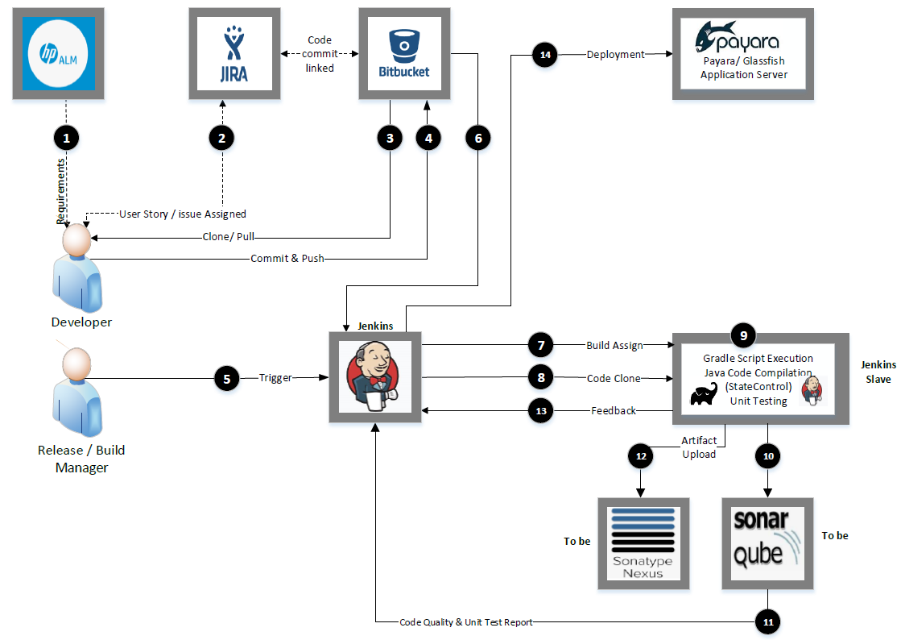
Java-deployment-process

Slide 7
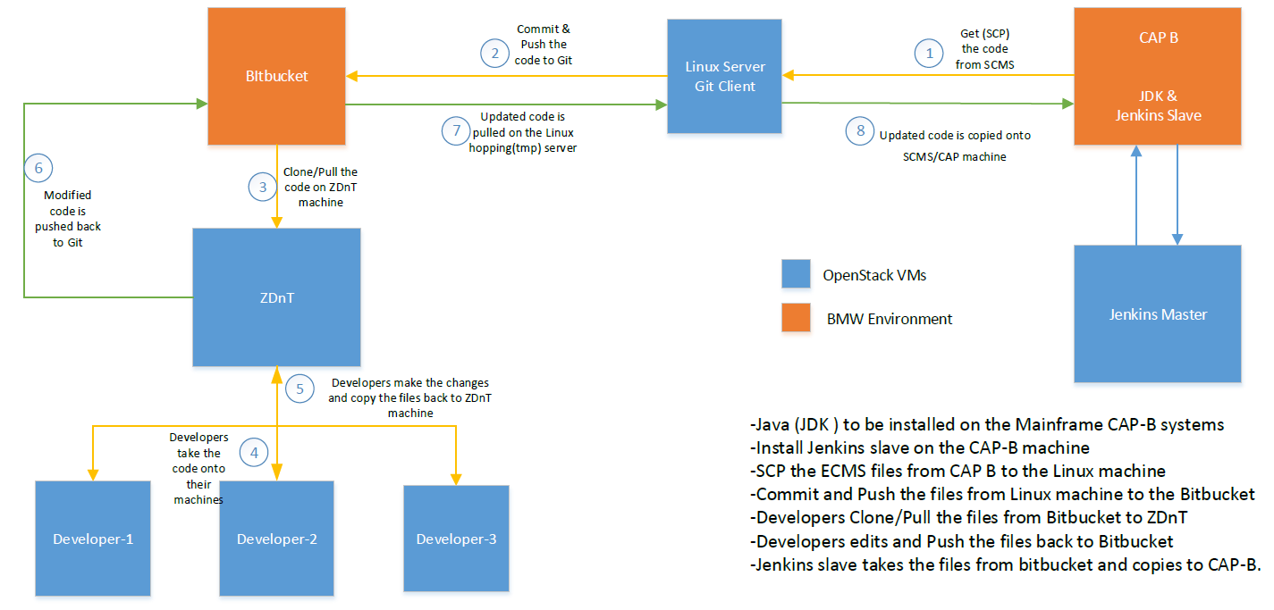
Mainframe DevOps plan

Slide 8

OpenStack, Bitbucket, Jenkins etc. BRIEF
QUESTIONS

